Slide 1
RMAN-Backup and Recovery
The Most Essential But The Most Ignored
Asif Momen
Senior Oracle DBA

Slide 2
Who am I?
Oracle ACE
12+ years of experience
Member, Editorial Board, Oracle Connect, All India Oracle User Group (AIOUG)
Oracle Certified Professional (OCP) 10g & 9i – Database & Oracle Forms
M.S. (Software Systems) from BITS – Pilani, India
Industries worked on: Education, Banking and High Technology
Oracle Blogger at: http://momendba.blogspot.com

Slide 3
Agenda
What Survey has to say about Backup & Recovery
Horror Stories
Test Environment
Recovery Scenario’s
  Loss of Parameter File (PFILE/SPFILE)
  Loss of Control Files
  Loss of Redo Log Files
  Basic Recovery Solutions
  Advanced Recovery Solutions
  Unsupported Recovery Solutions
  Data Unloader
References
Notes:
______________________________________________________________
______________________________________________________________
______________________________________________________________
______________________________________________________________
______________________________________________________________
______________________________________________________________
______________________________________________________________
______________________________________________________________
______________________________________________________________
______________________________________________________________
______________________________________________________________
______________________________________________________________
______________________________________________________________
______________________________________________________________
______________________________________________________________
______________________________________________________________
______________________________________________________________

Slide 4
What Survey has to say about Backup & Recovery
According to Symantec Survey, the average SMB only backs up 60% of customer data and doesn't even do that on a consistent schedule
Research conducted by Acronis reveals 38% of UK SMEs never backup their data. Full story is here.
Notes:
______________________________________________________________
______________________________________________________________
______________________________________________________________
______________________________________________________________
______________________________________________________________
______________________________________________________________
______________________________________________________________
______________________________________________________________
______________________________________________________________
______________________________________________________________
______________________________________________________________
______________________________________________________________
______________________________________________________________
______________________________________________________________
______________________________________________________________
______________________________________________________________
______________________________________________________________

Slide 5
Horror Stories
Ignacio Ruiz has recently put up a case where a customer was running a database with NO backups and a disaster hit them. Here is the complete story
Disaster Recovery Stories by Alejandro Vargas
OTN Forums is the other good place

Slide 6
Test Environment
Operating System
  Red Hat Enterprise Linux AS release 4 (Nahant Update 2)
  Windows XP SP-2
Database
  Oracle Database 11g Release 2 (11.2.0.1)
  Oracle Database 10g Release 2 Patch 3 (10.2.0.4)
  Data Block Size – 8K
  Archive Log Mode

Slide 7
Loss of Parameter File (PFILE/SPFILE)

Slide 8
Loss of Parameter File Scenario’s
SPF1: Loss of PFILE/SPFILE When No Backup Exists
SPF2: Restore SPFILE From Autobackup
SPF3: Restore SPFILE From Autobackup in FRA
SPF4: Restore SPFILE Using Recovery Catalog

Slide 9
SPF1: Loss of PFILE/SPFILE When No Backup Exists
Problem:
  Loss of PFILE/SPFILE
  You don’t have PFILE/SPFILE backup
Solution(s):
  Check database alert.log bottom-up
  When database is UP
    PFILE → Query V$PARAMETER2 view
    SPFILE → Query V$SPPARAMETER
  Create PFILE/SPFILE from memory (Oracle 11g)

Slide 10
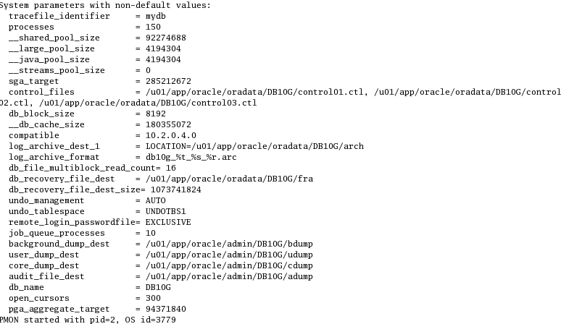
SPF1: Loss of PFILE/SPFILE When No Backup Exists
1) When Oracle instance starts, all non-default parameters are recorded in the database alert.log

Slide 11
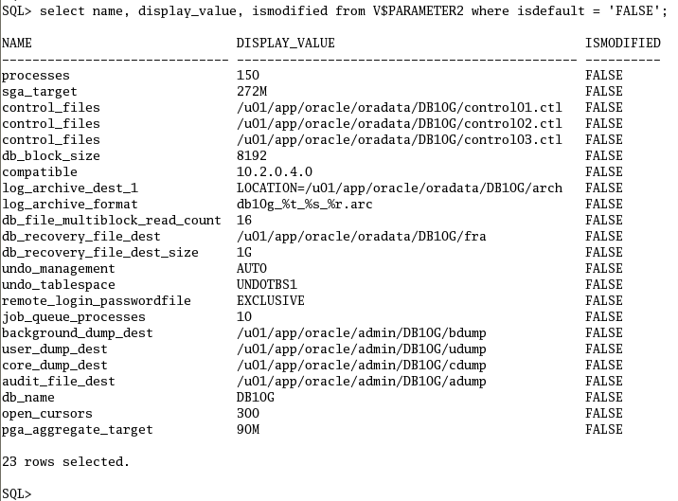
SPF1: Loss of PFILE/SPFILE When No Backup Exists
2) Output from V$PARAMETER2

Slide 12
SPF1: Loss of PFILE/SPFILE When No Backup Exists
Revert all the modified parameters to original values
Construct a PFILE
Create a SPFILE from the PFILE
Backup the recovered PFILE/SPFILE

Slide 13


SPF1: Loss of PFILE/SPFILE When No Backup Exists
3) Create PFILE/SPFILE from memory (Oracle 11g)
  PFILE
  SPFILE

Slide 14
SPF2: Restoring SPFILE From Autobackup
Problem:
  Database is DOWN
  SPFILE is lost
  Autobackup is configured
Solution:
  Start database instance in NOMOUNT mode without a parameter file
  Set DBID
  Restore SPFILE from Autobackup

Slide 15
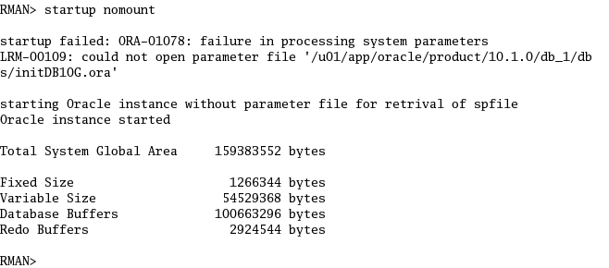

SPF2: Restoring SPFILE From Autobackup
Start database instance in NOMOUNT mode without a parameter file
Set DBID

Slide 16
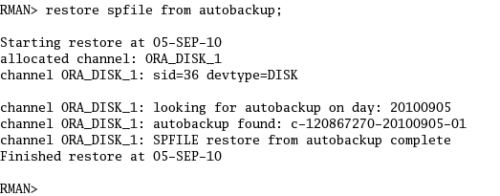
SPF2: Restoring SPFILE From Autobackup
Restore SPFILE from Autobackup

Slide 17
SPF3: Restoring SPFILE From FRA
Problem:
  Database is DOWN
  SPFILE is lost
  FRA is enabled
Solution:
  Start database instance in NOMOUNT mode without a parameter file
  Restore SPFILE from FRA

Slide 18
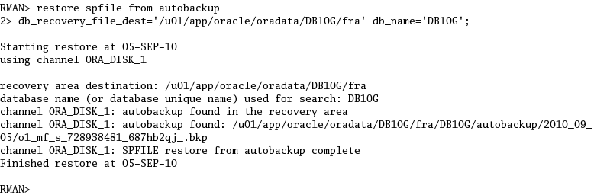
SPF3: Restoring SPFILE From FRA
Start database instance in NOMOUNT mode without a parameter file
Restore SPFILE from FRA

Slide 19
SPF4: Restore SPFILE Using Recovery Catalog
Problem:
  Database is DOWN
  SPFILE is lost
  Recovery Catalog Database is configured
Solution:
  Start database instance in NOMOUNT mode without a parameter file
  Restore SPFILE

Slide 20
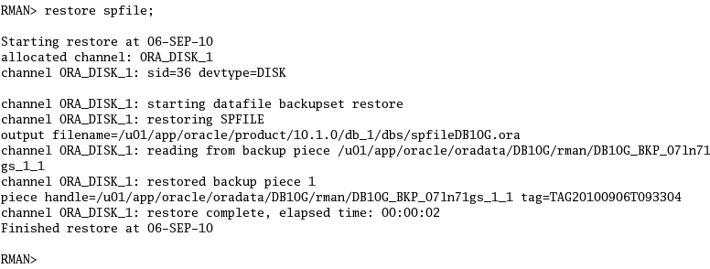
SPF4: Restore SPFILE Using Recovery Catalog
Restore SPFILE

Slide 21
Loss of Control File

Slide 22
Loss of Control File
CF1: Loosing one of the Multiplexed Control File’s
CF2: Loosing all Multiplexed Control Files (without a backup)
CF3: Restoring Control File From Autobackup
CF4: Restore Control File From Recovery Catalog
CF5: Restore Control File When FRA is Configured

Slide 23
CF1: Loosing one of the Multiplexed Control Files
Problem:
  Database is up
  One of the multiplexed control file is lost
Solution(s):
  1) Copy a good control file to the location of the missing control file
  2) Remove references to the missing control file from CONTROL_FILES initialization parameter

Slide 24
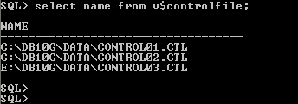
CF1: Loosing one of the Multiplexed Control Files
Simulating the problem:
Place one of the Control Files on a Pen Drive
Pen Drive
Remove the pen drive
Errors in file c:\db10g\dump\db10g_ckpt_5836.trc:
ORA-00206: error in writing (block 3, # blocks 1) of control file
ORA-00202: control file: 'E:\DB10G\DATA\CONTROL03.CTL'
ORA-27072: File I/O error
OSD-04008: WriteFile() failure, unable to write to file
O/S-Error: (OS 1006) The volume for a file has been externally altered so that the opened file is no longer valid.

Slide 25
CF2: Loosing all Multiplexed Control Files (without a backup)
Problem:
  All Control Files are lost
  No backup exists
Solution:
  Startup database instance in NOMOUNT mode
  Create a new Control File
  Open the database

Slide 26
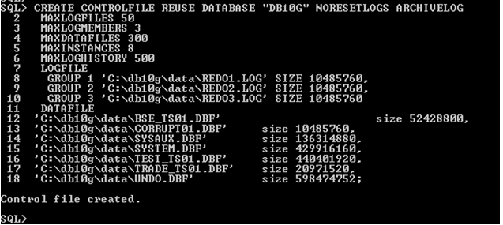
CF2: Loosing all Multiplexed Control Files (without a backup)
Creating a new Control File
  Startup database instance in NOMOUNT mode
  Use NORESETLOGS option as online redo log files are still good

Slide 27

CF2: Loosing all Multiplexed Control Files (without a backup)
Open Database

Slide 28
CF3: Restoring Control File From Autobackup
Problem:
  All Control Files are lost
  Autobackup is configured
Solution:
  Start database instance in NOMOUNT mode
  Set DBID in RMAN
  Restore control file from autobackup
  MOUNT the database
  Recover database
  Open the database with RESETLOGS option

Slide 29

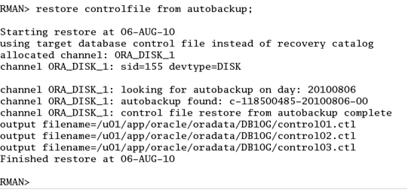
CF3: Restoring Control File From Autobackup
Start database instance in NOMOUNT mode
Set DBID in RMAN
Restore Control File

Slide 30

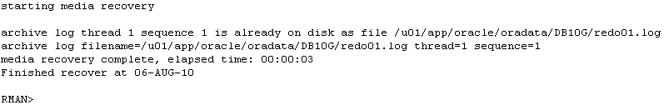
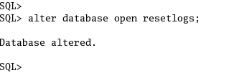
CF3: Restoring Control File From Autobackup
MOUNT database
Recover database
Open database with RESETLOGS option

Slide 31
CF4: Restore Control File From Recovery Catalog
Scenario:
  All Control Files are lost
  Recover Catalog is configured
Solution(s):
  Start database instance in NOMOUNT mode
  Restore control file
  MOUNT the database
  Recover database
  Open the database with RESETLOGS option

Slide 32
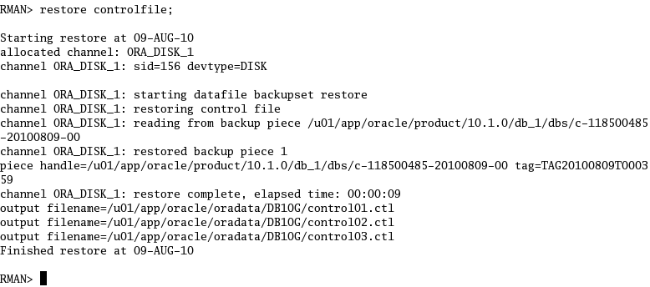
CF4: Restore Control File From Recovery Catalog
Start database instance in NOMOUNT mode
Restore Control File
  Setting DBID is not required as recover catalog is configured

Slide 33

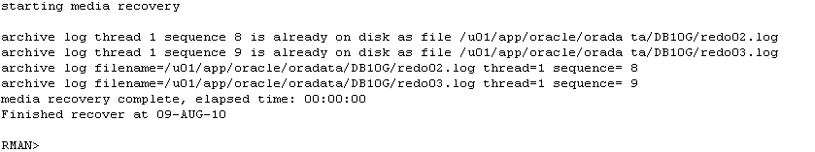
CF4: Restore Control File From Recovery Catalog
Recover database
Open database with RESETLOGS option

Slide 34
CF5: Restore Control File When FRA is Configured
Problem:
  All Control Files are lost
  Flash Recovery Area (FRA) is configured
  Autobackup feature is disabled
Solution(s):
  Start database instance in NOMOUNT mode
  Restore control file
  MOUNT the database
  Recover database
  Open the database with RESETLOGS option

Slide 35
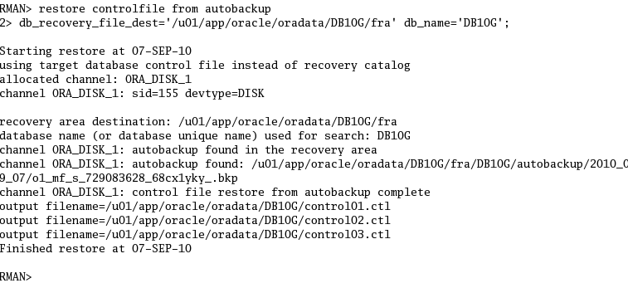
CF5: Restore Control File When FRA is Configured
Start database instance in NOMOUNT mode
Restore Control File

Slide 36
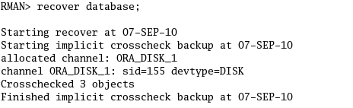
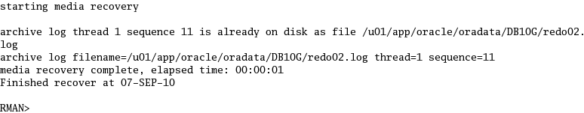
CF5: Restore Control File When FRA is Configured
MOUNT database
Recover database
  :

Slide 37
CF5: Restore Control File When FRA is Configured
Open database with RESETLOGS option

Slide 38
Loss of Redo Log Files

Slide 39
Loss of Redo Log Files
Understanding STATUS column of V$LOG and V$LOGFILE views
RLF1: Loosing a Member of Multiplexed Redo Log Files
RLF2: Loosing INACTIVE Redo Log Files
RLF3: Loosing CURRENT Redo Log Files
RLF4: Loosing ACTIVE Redo Log Files

Slide 40
Understanding STATUS of Redo Log Group (V$LOG)
The STATUS column of V$LOG view reflects the status of the log group:
CURRENT: The log group that is currently being written to by the log writer.
ACTIVE: The log group is required for crash recovery and may or may not have been archived.
INACTIVE: The log group isn’t needed for crash recovery and may or may not have been archived.
UNUSED: The log group has never been written to as it was recently created.

Slide 41
Understanding STATUS of Redo Log Files (V$LOG)
The STATUS column of V$LOGFILE reports the status of a online redo log file member :
INVALID: The log file member is inaccessible, or it has been recently created.
NULL: The log file member is being used by the database.

Slide 42
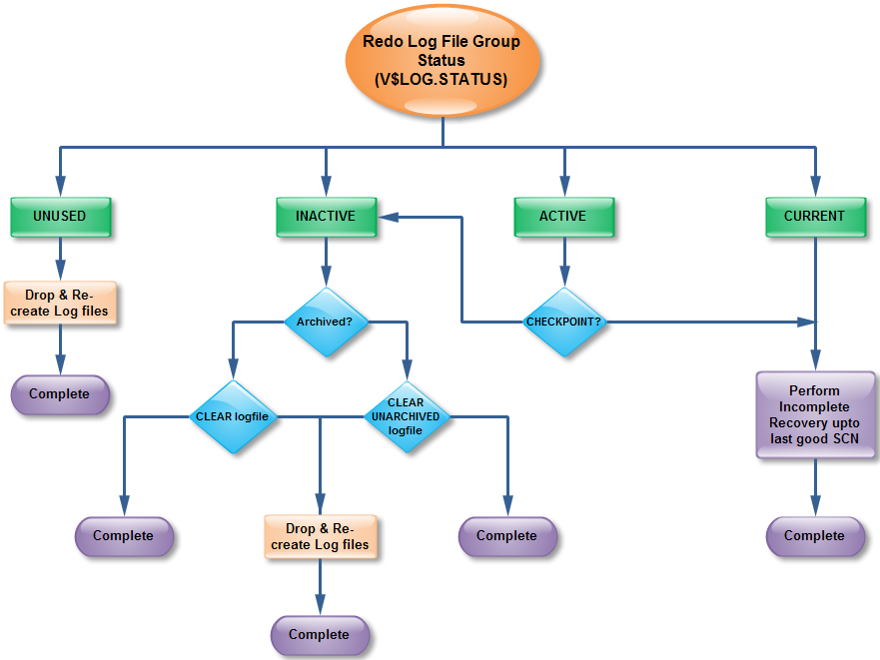
Recovering from Redo Log File Failures - Flowchart
YES
NO
SUCCESS
FAILURE
SUCCESS
FAILURE
SUCCESS

Slide 43
RLF1: Loosing a Member of Multiplexed Redo Log Files
Problem:
  A member of multiplexed redo log group is lost
  Database is UP
Solution(s):
  Fix the media or
  Drop the affected Redo Log File and Create a new one in a different location

Slide 44
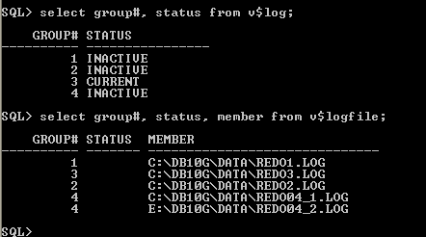
RLF1: Loosing a Member of Multiplexed Redo Log Files
Simulating Media Failure
  Place one of the Redo Log member on a pen drive
Pen Drive
Unplug the pen drive while database is still in open mode
Oracle Instance remains up and continues to function normally while reporting errors in alert.log

Slide 45
RLF1: Loosing a Member of Multiplexed Redo Log Files
Perform few log switches and monitor alert.log
Errors in file c:\db10g\dump\db10g_lgwr_3724.trc:
ORA-00321: log 4 of thread 1, cannot update log file header
ORA-00312: online log 4 thread 1: 'E:\DB10G\DATA\REDO04_2.LOG'
ORA-27091: unable to queue I/O
ORA-27070: async read/write failed
OSD-04008: WriteFile() failure, unable to write to file
O/S-Error: (OS 1006) The volume for a file has been externally altered so that the opened file is no longer valid.
Sat Aug 14 20:43:50 2010
Errors in file c:\db10g\dump\db10g_lgwr_3724.trc:
ORA-00313: open failed for members of log group 4 of thread 1

Slide 46
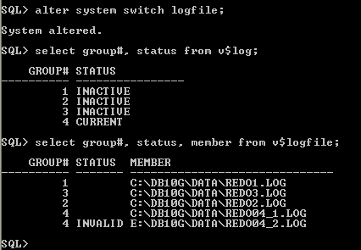
RLF1: Loosing a Member of Multiplexed Redo Log Files
Oracle marks the unavailable Redo Log file as INVALID
Database remains UP

Slide 47
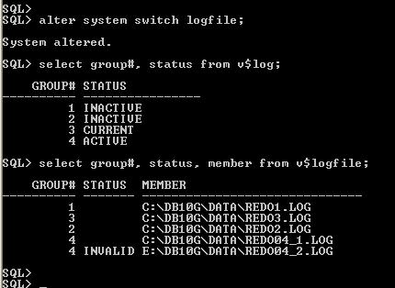
RLF1: Loosing a Member of Multiplexed Redo Log Files
Force a log switch
  Log Group Status = ACTIVE
  Member Status = INVALID

Slide 48
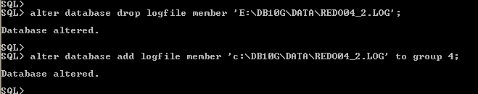
RLF1: Loosing a Member of Multiplexed Redo Log Files
Solution(s):
Fix the media (plug in the pen drive)
    Log Writer continues writing to the Redo Log File as if the problem never existed
    The V$LOG.STATUS is updated to NULL
2) Drop and recreate the affected member to a different location

Slide 49
RLF2: Loosing INACTIVE Redo Log Files
Problem:
  The only member of the redo log group is lost
  Status of the Redo Log Group is INACTIVE
  Database is Up
Solution(s):
  If this is a temporary media failure, fix the issue and start database
  If the redo log file is lost while the media remains available then clear the archvied/unarchived log file
  If the media failure is permanent then drop and re-create the redo log group to a new location

Slide 50
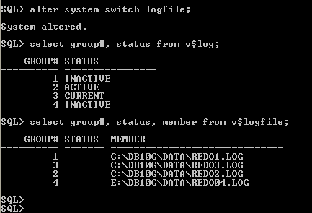
RLF2: Loosing INACTIVE Redo Log Files
Simulating Media Failure
  Create a Redo Log Group with a single member on a pen drive
  Unplug the pen drive while the database is still open and V$LOG.STATUS = INACTIVE
  Perform log switches until Oracle tries to reuse the redo log file residing in the pen drive
Pen Drive

Slide 51
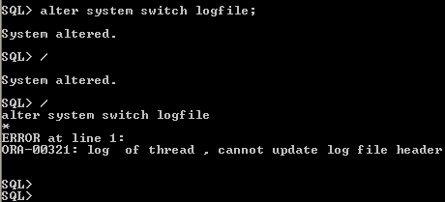
RLF2: Loosing INACTIVE Redo Log Files
  LGWR terminates the instance with ORA-00321 error as shown:
Errors in file c:\db10g\dump\db10g_lgwr_1348.trc:
ORA-00321: log 4 of thread 1, cannot update log file header
ORA-00312: online log 4 thread 1: 'E:\DB10G\DATA\REDO04.LOG'
ORA-27091: unable to queue I/O
ORA-27070: async read/write failed
OSD-04008: WriteFile() failure, unable to write to file
O/S-Error: (OS 1006) The volume for a file has been externally altered so that the opened file is no longer valid.
Sat Aug 14 21:06:15 2010
Errors in file c:\db10g\dump\db10g_lgwr_1348.trc:
ORA-00321: log 4 of thread 1, cannot update log file header
LGWR: terminating instance due to error 321
Sat Aug 14 21:06:16 2010
Errors in file c:\db10g\dump\db10g_q001_4008.trc:
ORA-00321: log of thread , cannot update log file header
  Alert.log →

Slide 52
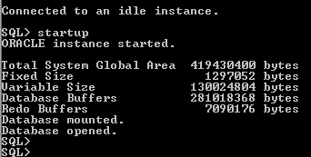
RLF2: Loosing INACTIVE Redo Log Files
Solution(s):
Fix the media (plug in the pen drive)
    Start database
    Oracle performs crash recovery behind the scenes
    The V$LOG.STATUS is updated to NULL

Slide 53
RLF2: Loosing INACTIVE Redo Log Files
  Crash recovery information in database alert.log
ALTER DATABASE OPEN
Sat Aug 28 01:32:17 2010
Beginning crash recovery of 1 threads
parallel recovery started with 2 processes
Sat Aug 28 01:32:17 2010
Started redo scan
Sat Aug 28 01:32:18 2010
Completed redo scan
0 redo blocks read, 0 data blocks need recovery
Sat Aug 28 01:32:18 2010
Started redo application at
Thread 1: logseq 907, block 2, scn 90480632
Sat Aug 28 01:32:18 2010
Recovery of Online Redo Log: Thread 1 Group 2 Seq 907 Reading mem 0
Mem# 0: C:\DB10G\DATA\REDO2.LOG
Sat Aug 28 01:32:18 2010
Completed redo application
Sat Aug 28 01:32:18 2010
Completed crash recovery at
Thread 1: logseq 907, block 2, scn 90500633
0 data blocks read, 0 data blocks written, 0 redo blocks read
Sat Aug 28 01:32:19 2010

Slide 54
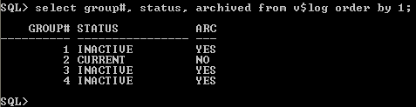


RLF2: Loosing INACTIVE Redo Log Files
2) If the redo log file is lost while the media remains available then clear the archived/unarchived log file
  Identify whether redo log was archived or not by querying V$LOG view
  If the redo log file is archived then use CLEAR ARCHIVED command
  If the redo log file is not archived then use CLEAR UNARCHIVED command
  Open database

Slide 55
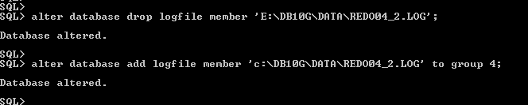

RLF2: Loosing INACTIVE Redo Log Files
Solution(s):
  3) If the media failure is permanent then drop and re-create the redo log group to a new location
    - Drop and Re-create
    - Open Database

Slide 56
RLF3: Loosing CURRENT Redo Log Files
Problem:
  All the member of an CURRENT redo log group are lost
  Valid database backup exist
Solution:
  Startup database in MOUNT mode
  Identify the last good SCN
  Restore database until last good SCN
  Recover database until last good SCN
  Re-create the redo log group to a different location
  Open database with RESETLOGS option

Slide 57
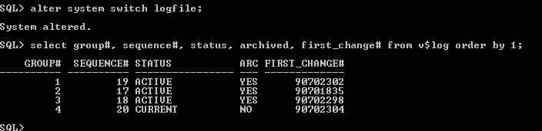

RLF3: Loosing CURRENT Redo Log Files
Simulating Media Failure
  Create a Redo Log Group with a single member on a pen drive
  Switch archive logs until the status of redo log residing in pen drive changes to CURRENT
  Create a test table
  Unplug the pen drive

Slide 58
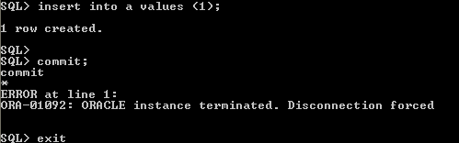
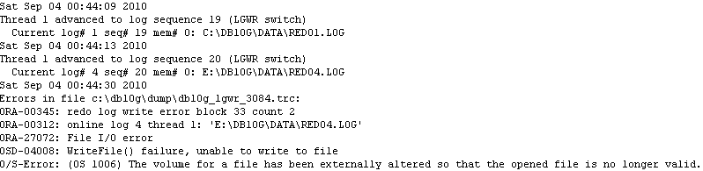

RLF3: Loosing CURRENT Redo Log Files
Simulating Media Failure
  LGWR terminates the instance as it is not able to write to the CURRENT online redo log group

Slide 59
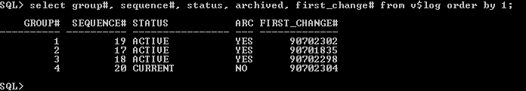
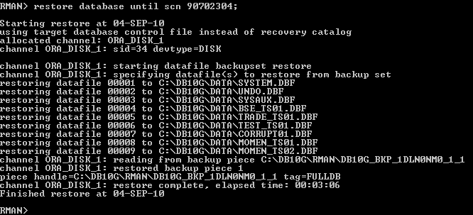
RLF3: Loosing CURRENT Redo Log Files
Solution:
  Startup database in MOUNT mode
  Identify the last good SCN
  Restore database until last good SCN (90702304)

Slide 60
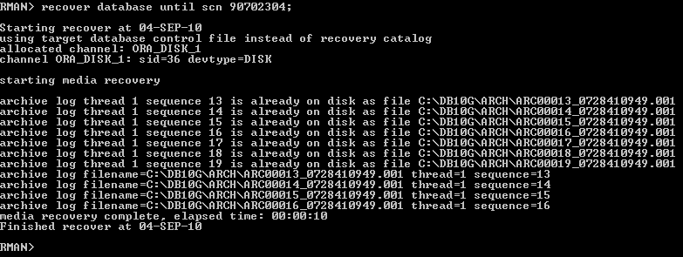

RLF3: Loosing CURRENT Redo Log Files
Solution:
  Recover database until the last good SCN (90702304)
  Re-create the redo log group to a different location

Slide 61


RLF3: Loosing CURRENT Redo Log Files
Solution:
  Open database with RESTELOGS options
  Test the existence of the test table (“A”)

Slide 62
RLF4: Loosing ACTIVE Redo Log Files
Problem:
  All the member of an ACTIVE redo log group are lost
  Database is Up
Solution:
  Issue a Checkpoint
  Check redo log status
  If Checkpoint is SUCCESS then CLEAR redo log group.
  If Checkpoint FAILS to complete then perform incomplete recovery by identifying the last good SCN

Slide 63
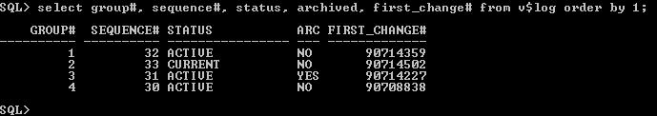
RLF4: Loosing ACTIVE Redo Log Files
Simulating Media Failure
  Create a Redo Log Group with a single member on a pen drive
  Unplug the pen drive while the database is in open mode and V$LOG.STATUS = ACTIVE

Slide 64

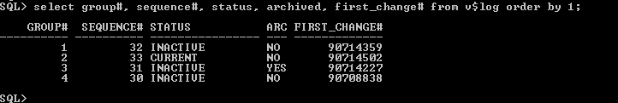
RLF4: Loosing ACTIVE Redo Log Files
Solution:
  Issue a Checkpoint
  Check redo log status

Slide 65

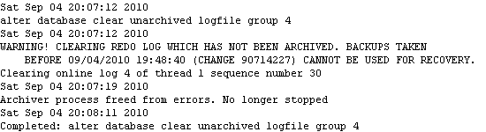
RLF4: Loosing ACTIVE Redo Log Files
Solution:
  If Checkpoint is SUCCESS then CLEAR redo log group.
  If there is a failure to complete the checkpoint then perform incomplete recovery by identifying the last good SCN as discussed in RLF3-Scenario.

Slide 66
Basic Recovery Solutions

Slide 67
Basic Recovery Solutions
Datafile Recovery
Tablespace Recovery
Recovering Read-Only Tablespace
Recovering Temporary Tablespace
Tablespace Point-In-Time Recovery (TSPITR)
Flashback Database

Slide 68
Datafile Recovery
Problem:
  One of the Datafiles is lost
  Database is Up
  Valid backups exist
Solution:
  Offline all the required datafiles
  Restore the affected datafiles
  Recover datafiles
  Bring back the datafiles to online state
  Verify restore

Slide 69
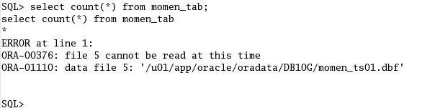
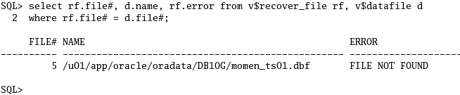

Datafile Recovery
Solution:
  Query any of the tables residing in the datafile
  Find all datafiles that need recovery
  Take the datafile(s) offline

Slide 70
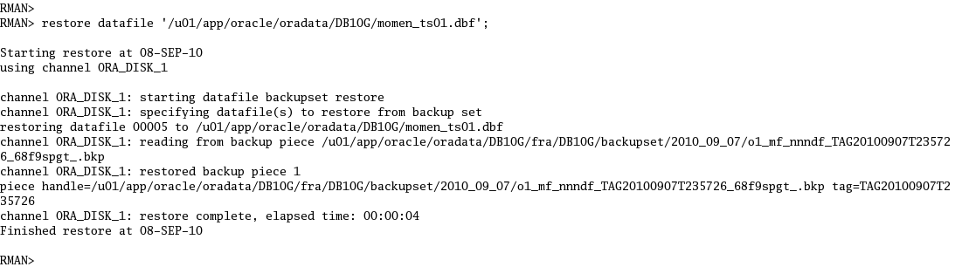
Datafile Recovery
  Restore datafiles affected by media failure

Slide 71
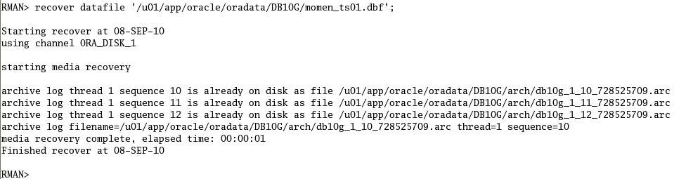

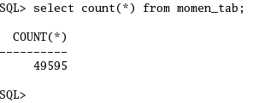
Datafile Recovery
  Recover datafiles
  Bring back the datafiles to online state
  Verify restore

Slide 72
Tablespace Recovery
Problem:
  Several datafiles of a tablespace are affected
  Database is Up
  Valid backups exist
Solution:
  Offline the affected tablespace
  Restore tablespace
  Recover tablespace
  Bring back the tablespace to online state
  Verify restore

Slide 73
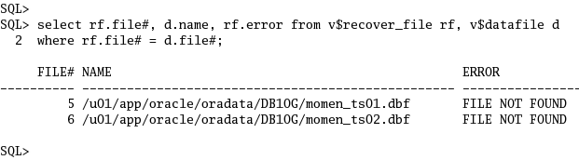

Tablespace Recovery
Solution:
  Query V$RECOVER_FILE to view datafiles that need to be recovered
  Take the tablespace(s) offline

Slide 74
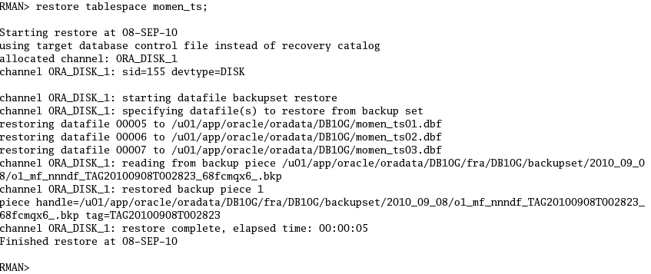
Tablespace Recovery
  Restore tablespace

Slide 75
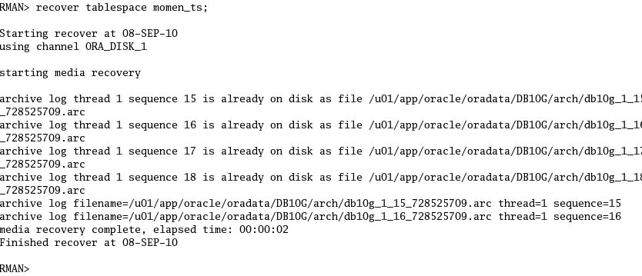
Tablespace Recovery
  Recover tablespace

Slide 76

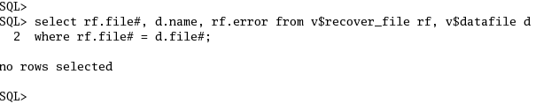
Tablespace Recovery
  Bring the tablespace to online state
  Check any datafiles still need to be recovered

Slide 77
Recovering Read-Only Tablespaces
Problem:
  Full database restore is performed
  Read-only tablespaces were ignored by RMAN during restore
Solution:
  Use CHECK READONLY option during database restore
  Alternatively, explicitly restore the tablespaces which are in read-only mode

Slide 78

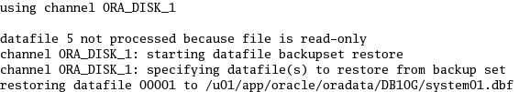
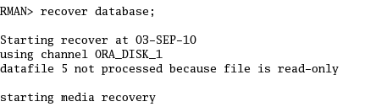
Recovering Read-Only Tablespaces
By default “restore database” will ignore tablespaces in read-only mode
Also “recover database” command will ignore tablespaces in read-only mode

Slide 79
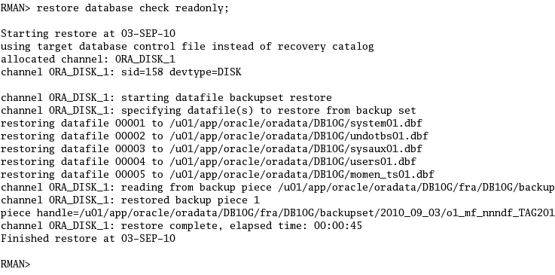
Recovering Read-Only Tablespaces
Restore database using CHECK READONLY option

Slide 80
Recovering Temporary Tablespaces
As tempfiles aren't checkpointed, we don't need to back them up. We can recreate them at any point after the database has been restored, recovered and opened
Temporary datafiles that belong to locally managed temporary tablespaces are automatically re-created during database recovery. This eliminates the need to manually create temporary tablespaces after recovery

Slide 81
Tablespace Point-In-Time Recovery (TSPITR)
Problem:
  A TRUNCATE TABLE statement was erroneously run in production
  Database is UP
  Valid database backup’s exist
Solution:
  List all the objects residing in the affected tablespace
  Identify and resolve any dependencies
  Backup all the objects that will be lost
  Create an auxiliary destination
  Recover the tablespace
  Bring the tablespace online

Slide 82
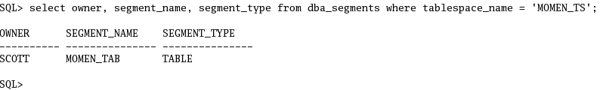
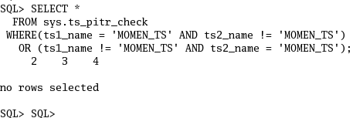
Tablespace Point-In-Time Recovery (TSPITR)
Solution:
  List all the objects residing in the tablespace
  Identify and resolve any dependencies

Slide 83
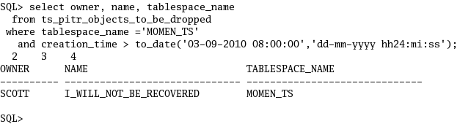

Tablespace Point-In-Time Recovery (TSPITR)
  Backup all the objects that will be lost
    Identify objects what will be lost during TSPITR by querying TS_PITR_OBJECTS_TO_BE_DROPPED view on the primary database
  Create an Auxiliary destination

Slide 84


Tablespace Point-In-Time Recovery (TSPITR)
  Recover the tablespace
  Bring the tablespace online
  Verify TSPITR process

Slide 85
Tablespace Point-In-Time Recovery (TSPITR)
How the Recover command in TSPITR works?
  Creates an automatic instance
  Restores Control File in the auxiliary (AUXDB) location
  Restores and recovers the tablespaces SYSTEM, UNDO, and data tablespace (MOMEN_TS)
  Export tablespace metadata in Recovery Set
  Cleans auxiliary instance

Slide 86
Flashback Database
Problem:
  An erroneous transaction was performed (TRUNCATE)
  Database is in Flashback mode
Solution:
  Identify the SCN to flashback to
  Shutdown database
  Start database in MOUNT mode
  Flashback database
  Open database with RESETLOGS option
  Verify table contents

Slide 87



Flashback Database
Scenario:
  Create a table (T1) and insert some records
  Make a note of SCN
  TRUNCATE table T1

Slide 88
Flashback Database
Solution:
  Identify the SCN to flashback to
    SCN = 476693
  Shutdown database
  Start database in MOUNT mode

Slide 89



Flashback Database
Solution:
  Flashback database
  Open database with RESETLOGS option
  Verify results

Slide 90
Advanced Recovery Solutions

Slide 91
Advanced Recovery Solutions
Recovering Datafiles Not Backed Up
Recovering through RESETLOGS
Recovering to a Restore Point
Recovering to a Previous Incarnation
Partial Restore of a Database
Block Recovery

Slide 92
Recovering Datafiles Not Backed Up
Problem:
  New datafile is added to a tablespace (MOMEN_TS)
  Datafile was lost before it could be backed up
  Valid database backup exists
  All Archive logs exist
  Database is UP
Solution:
  List datafiles that need recovery
  Restore datafile
  Recover tablespace
  Verify contents

Slide 93



Recovering Datafiles Not Backed Up
Simulating Loss of Datafile
  Create a tablespace (MOMEN_TS) with one of the datafiles residing in pen drive
  Create and populate a table (MOMEN_TAB) in the above tablespace
  Switch archive logs

Slide 94

Recovering Datafiles Not Backed Up
Simulating Loss of Datafile (cont …)
  Unplug the pen drive
  Switch archive logs
  Verify the status

Slide 95

Recovering Datafiles Not Backed Up
Simulating Loss of Datafile (cont …)
  Datafile backup exists?
  Plug the pen drive and delete the datafile (MOMEN_TS02.DBF)

Slide 96


Recovering Datafiles Not Backed Up
Solution:
  Restore datafile
  Recover datafile

Slide 97


Recovering Datafiles Not Backed Up
Solution:
  Bring the tablespace online
  Verify restore and recovery

Slide 98
Recovering through RESETLOGS
Problem:
  Incomplete database recovery was performed (RESETLOGS)
  Soon after restore completed, you suffered from another media failure
  Backup was not performed after opening database with RESETLOGS option
  All the generated archive logs exist
Solution:
  Start database in NOMOUNT mode
  Restore Control File
  MOUNT database
  Restore database
  Recover database
  Open database with RESETLOGS option

Slide 99


Recovering through RESETLOGS
Solution:
  List incarnations of the current database
  Restore Control File

Slide 100

Recovering through RESETLOGS
Solution:
  MOUNT database
  Restore database

Slide 101

Recovering through RESETLOGS
Solution:
  Recover database
  Open database with RESETLOGS option
Archive Log (955) from
PREVIOUS Incarnation
Archive Logs (1, 2, 3, & 4) from
CURRENT Incarnation

Slide 102


Recovering through RESETLOGS
Solution:
  Open database with RESETLOGS option
  List database incarnations

Slide 103
Recovering to a Restore Point
Problem:
  You have created a Restore Point
  You want to restore database to the created Restore Point
  Valid database backup exists
Solution:
  List Restore Points
  MOUNT database
  Restore database until Restore Point
  Recover database until Restore Point
  Open database with RESETLOGS option
  Verify restore

Slide 104



Recovering to a Restore Point
Simulating:
  Create a table (PRE_RP) and dump some records
  Create a Restore Point
  Create a table (POST_RP) and dump some records

Slide 105

Recovering to a Restore Point
Solution:
  List Restore Points
  Shutdown and start database in MOUNT mode

Slide 106

Recovering to a Restore Point
Solution:
  Restore database until Restore Point

Slide 107


Recovering to a Restore Point
Solution:
  Recover database until Restore Point
  Open database with RESETLOGS option

Slide 108



Recovering to a Restore Point
Solution:
  Verify Restore
  Make a note of the time as this will be used for the next recovery scenario

Slide 109
Recovering to a Previous Incarnation
Problem:
  You performed an incomplete recovery
  Now you want to go back in time prior to the time when database was opened with resetlogs
  Valid database backup exists
Solution:
  List database incarnations
  Restore Control File
  MOUNT database
  Reset database incarnation
  Restore database until Time
  Recover database until time
  Open database with RESETLOGS option
  Verify restore

Slide 110


Recovering to a Previous Incarnation
Solution:
  List database incarnations
  Restore Control File

Slide 111


Recovering to a Previous Incarnation
Solution:
  MOUNT database
  Reset database incarnation

Slide 112


Recovering to a Previous Incarnation
Solution:
  Restore database until Time

Slide 113


Recovering to a Previous Incarnation
Solution:
  Recover database until time
  Open database with RESETLOGS option

Slide 114


Recovering to a Previous Incarnation
Solution:
  Verify restore
  We have managed to restore the POST_RP table which was created immediately after creating the Restore Point (MOMEN_RP)

Slide 115
Partial Restore of a Database
Problem:
  Database is very large
  Need to recover few tables due to erroneous transaction
  Valid database backups exist
Solution:
  Identify required tablespaces and datafiles
  Copy init.ora to a different host
  Start instance in NOMOUNT state
  Restore control file
  Restore required tablespaces
  Delete the existing control file and create a new one with the required datafiles only
  Recover database
  Open database with RESETLOGS
  Confirm contents of table T
  Export the table (T) and import into production database

Slide 116

Partial Restore of a Database
Scenario:
  Note the number of records in the test table “T”
  Make a note of the time
  Perform erroneous transaction

Slide 117

Partial Restore of a Database
Solution:
  Identify required tablespaces and datafiles
  Copy init.ora to a different host
  Start instance in NOMOUNT state

Slide 118

Partial Restore of a Database
Solution:
  Restore Control File

Slide 119

Partial Restore of a Database
Solution:
  Restore required tablespaces

Slide 120

Partial Restore of a Database
Solution:
  Delete the existing control file and create a new one with the required datafiles only

Slide 121

Partial Restore of a Database
Solution:
  Recover database

Slide 122

Partial Restore of a Database
Solution:
  Open database with RESETLOGS
  Confirm contents of table T
  Export the table (T) and import into production database

Slide 123
Block Recovery
Problem:
  Few data blocks are reported as corrupt
  RMAN Backups are safe
Solution:
  Identify and list corrupt blocks
  Perform Block Recovery
  Verify results

Slide 124
Block Recovery
Scenario:
  Create a test table (T) in tablespace “X” and insert dummy data
  Take the tablespace (“X”) offline
  Open the data file that belongs to tablespace “X” using UltraEdit
  Make changes to the data, save and close the data file
  Bring the tablespace online
  Querying table T should report data corruption
  For more details read my post Practicing Block Recovery

Slide 125



Block Recovery
Solution:
  Identify and list corrupt blocks

Slide 126


Block Recovery
  Perform Block Recovery
  Verify results

Slide 127
Unsupported Recovery Solutions

Slide 128
Unsupported Recovery Solutions
Recovering From RMAN Backup Pieces
Recovering an Inconsistent Database

Slide 129
Recovering from RMAN Backup Pieces
Problem:
  All you have is RMAN backup pieces
  SPFILE, Control File are included in the backup pieces
Solution:
  List all backup pieces
  Startup database instance in NOMOUNT mode without parameter file
  Extract SPFILE from the backup pieces
  Extract Control File from the backup pieces
  Shutdown and start database in MOUNT mode using restored SPFILE and Control Files
  Restore and recover database
  Open database with RESETLOGS option

Slide 130


Recovering from RMAN Backup Pieces
Solution:
  List all backup pieces
  Startup database instance in NOMOUNT mode without parameter file

Slide 131


Recovering from RMAN Backup Pieces
Solution:
  Extract SPFILE from the backup pieces using DBMS_BACKUP_RESTORE package
  Verify the extracted SPFILE

Slide 132

Recovering from RMAN Backup Pieces
Solution:
  Extract Control Files from the backup pieces using DBMS_BACKUP_RESTORE package

Slide 133

Recovering from RMAN Backup Pieces
Solution:
  Verify extracted Control Files
  Shutdown and start database in MOUNT mode using restored SPFILE and Control Files
  View backup information from the control file
  Restore and recover database
  Open database with RESETLOGS option

Slide 134

Recovering from RMAN Backup Pieces
Solution:
  Shutdown and start database in MOUNT mode using restored SPFILE and Control Files
  View backup information from the control file
  Restore and recover database
  Open database with RESETLOGS option

Slide 135
Recovering an Inconsistent Database
Problem:
  Full database backup exists as of day “X”
  A backup of SYSTEM, SYSAUX, and data tablespace (MOMEN_TS) exists as of day “Y”
  Few Archive log’s are missing between day “X” and day “Y”
  Your database is in inconsistent mode

Slide 136
Recovering an Inconsistent Database
Solution:
  Check SCN of datafiles
  Edit init<sid>.ora to include hidden parameters and modify undo management
  Start database instance in MOUNT mode
  Bring all datafiles online
  Perform a fake recovery
  Open database with RESETLOGS
  If the instance crashes then set “10015” event
  Open database with RESETLOGS

Slide 137
Recovering an Inconsistent Database
Simulating:
How to make an inconsistent database
  Take a full database backup
  Make some changes (like create a table)
  Delete at least one archivelog
  Take backup of SYSTEM, SYSAUX, & MOMEN_TS tablespaces
  Restore database

Slide 138

Recovering an Inconsistent Database
Solution:
  Check SCN of datafiles

Slide 139
Recovering an Inconsistent Database
Solution:
  Edit init<sid>.ora to include hidden parameters and modify undo management
    _ALLOW_RESETLOGS_CORRUPTION=TRUE
    _ALLOW_ERROR_SIMULATION=TRUE
    _CORRUPTED_ROLLBACK_SEGMENTS=(comma separated list of Automatic Undo segments)
    UNDO_MANAGEMENT=MANUAL

Slide 140
_ALLOW_RESETLOGS_CORRUPTION
  This parameter forces the opening of the datafiles even if their SCNs do not match up
  Allow RESETLOGS even if it will cause corruption
_ALLOW_ERROR_SIMULATION
  Allow error simulation for testing
_CORRUPTED_ROLLBACK_SEGMENTS
  Corrupted undo segment list

Slide 141

Recovering an Inconsistent Database
Solution:
  Run the following command on UNIX to get undo segment names
    $ strings system01.dbf | grep _SYSSMU | cut -d $ -f 1 | sort –u

Slide 142

Recovering an Inconsistent Database
Solution:
  Start database instance in MOUNT mode
  Confirm the new parameters are set properly

Slide 143


Recovering an Inconsistent Database
Solution:
  Bring all datafiles online
  Perform a fake recovery
  Open database with RESETLOGS

Slide 144


Recovering an Inconsistent Database
Solution:
  If the instance crashes then check the trace files and alert log for ORA-00600 [2662] error in it.
  MOUNT the database and set “10015” event

Slide 145


Recovering an Inconsistent Database
Solution:
  Open database
  Confirm that the database is functional

Slide 146
Recovering an Inconsistent Database
If the instance crashes again, check the trace file for another ORA-00600 [2662] error.
If so, increment the LEVEL by 1 and repeat (Increment 10015 Event & Open database) until you can successfully open the database.
If you need to go beyond 'LEVEL 6' or 'LEVEL 7', then the database is probably beyond forcing open ☹

Slide 147
Data Unloader

Slide 148
Data Unloader (DUL)
DUL is the process of extracting data from Oracle data files directly.
DUL completely bypassing the Oracle Kernel.
Contact Oracle Support
For more information on third party Data Unloader products you may read DUL & Desperation: The Trials and Tribulations of Corruption by Jonah H. Harris

Slide 149
References
Oracle Documentation (Release 10g R2 and 11g R1 & R2)
Oracle database recovery with data unloading by Ignacio Ruiz
Disaster Recovery Stories by Alejandro Vargas
Dell Simplifies Backup And Recovery For SMBs by Symantec
UK SMEs in data recovery failure by Acronis
DUL & Desperation: The Trials and Tribulations of Corruption by Jonah H. Harris
When you lost your controlfile backups by Coskan Gundogar
Practicing Block Recovery by Asif Momen
RMAN Recipes for Oracle Database 11g by Darl Kuhn, Sam Alapati, and Arup Nanda
Oracle Support

Slide 150
Thank you for your interest
For more information and to provide feedback please contact me
My e-mail address is:
asif.momen@gmail.com
My blog address is:
http://momendba.blogspot.com

